Slide 1

Pilot Success
Jake Rose, Andy O’Bryan, Stacey Smoot

Slide 2
Background
The Leadership In Flight Training (LIFT) Academy offers pilot training programs including a direct classroom-to-cockpit opportunity. Working with Republic Airlines, LIFT Academy training has the potential to advance to Captain. The programs are tailored around each student’s schedule.

Slide 3
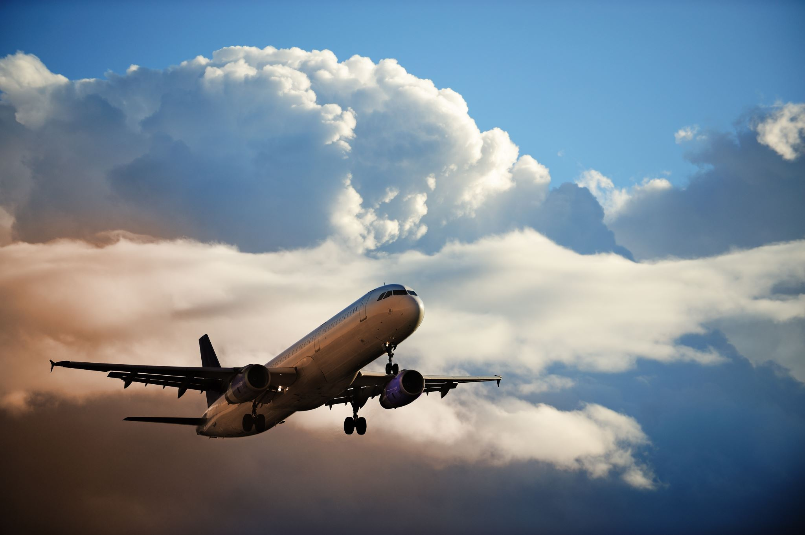
"Without the pilot, there is no flying from one place to another."
- Lailah Gifty Akita.

Slide 4
Prediction and Goal
Using real data from Lift Academy to determine a student’s flight hours based on days spent within the course. This will be used to predict time requirements for new students and cost per student for the company. In the future, additional information can be added to this to determine how much time it will take a multicourse student to complete all necessary training to become a trainer or move to domestic/national flight captain.

Slide 5

Prospects
In the future, exact monetary amounts per class can be added to better see the financial side of student commitment. In addition, more data can be compiled and added to the machine learning model to determine time dedication needed to fulfill the contract with Republic Airlines plus instructors needed to keep onboard at LIFT Academy.

Slide 6
Data and Cleaning
Start
Start with Graduate Roster
Add
Add columns: Course Count, Start Month, Target Hours, Target Days
Calculate
Calculate: Variance Hours, Variance Days
Initiate
Initiate machine learning

Slide 7
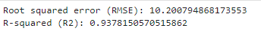
Machine Learning
Supervised Multiple Linear Regression
Features: Course Short Name, Start Month, Course Flight Hours, E2E Course Days Course Count
Target: Course Flight Hours

Slide 8
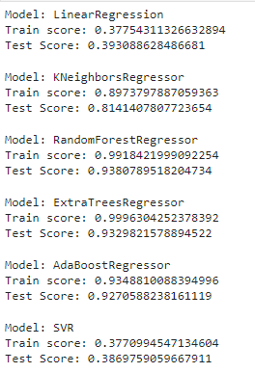
Machine Learning
Despite great R2 score on Linear Regression Model, get dummies lead to errors and different models were assessed to determine the best course of action.

Slide 9
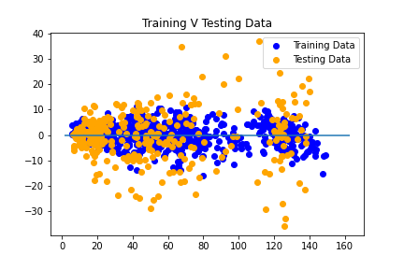
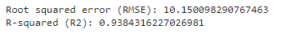
Random Forest Regressor Model
The model is successful and can reasonably predict how profitable a student can be within a class.

Slide 10
Code
Libraries Used
- Pandas - Matplotlib
- numpy - sklearn
- pickle - javascript
- HTML - CSS
- flask - json
https://github.com/JakeRose689/Pilot-Success

Slide 11
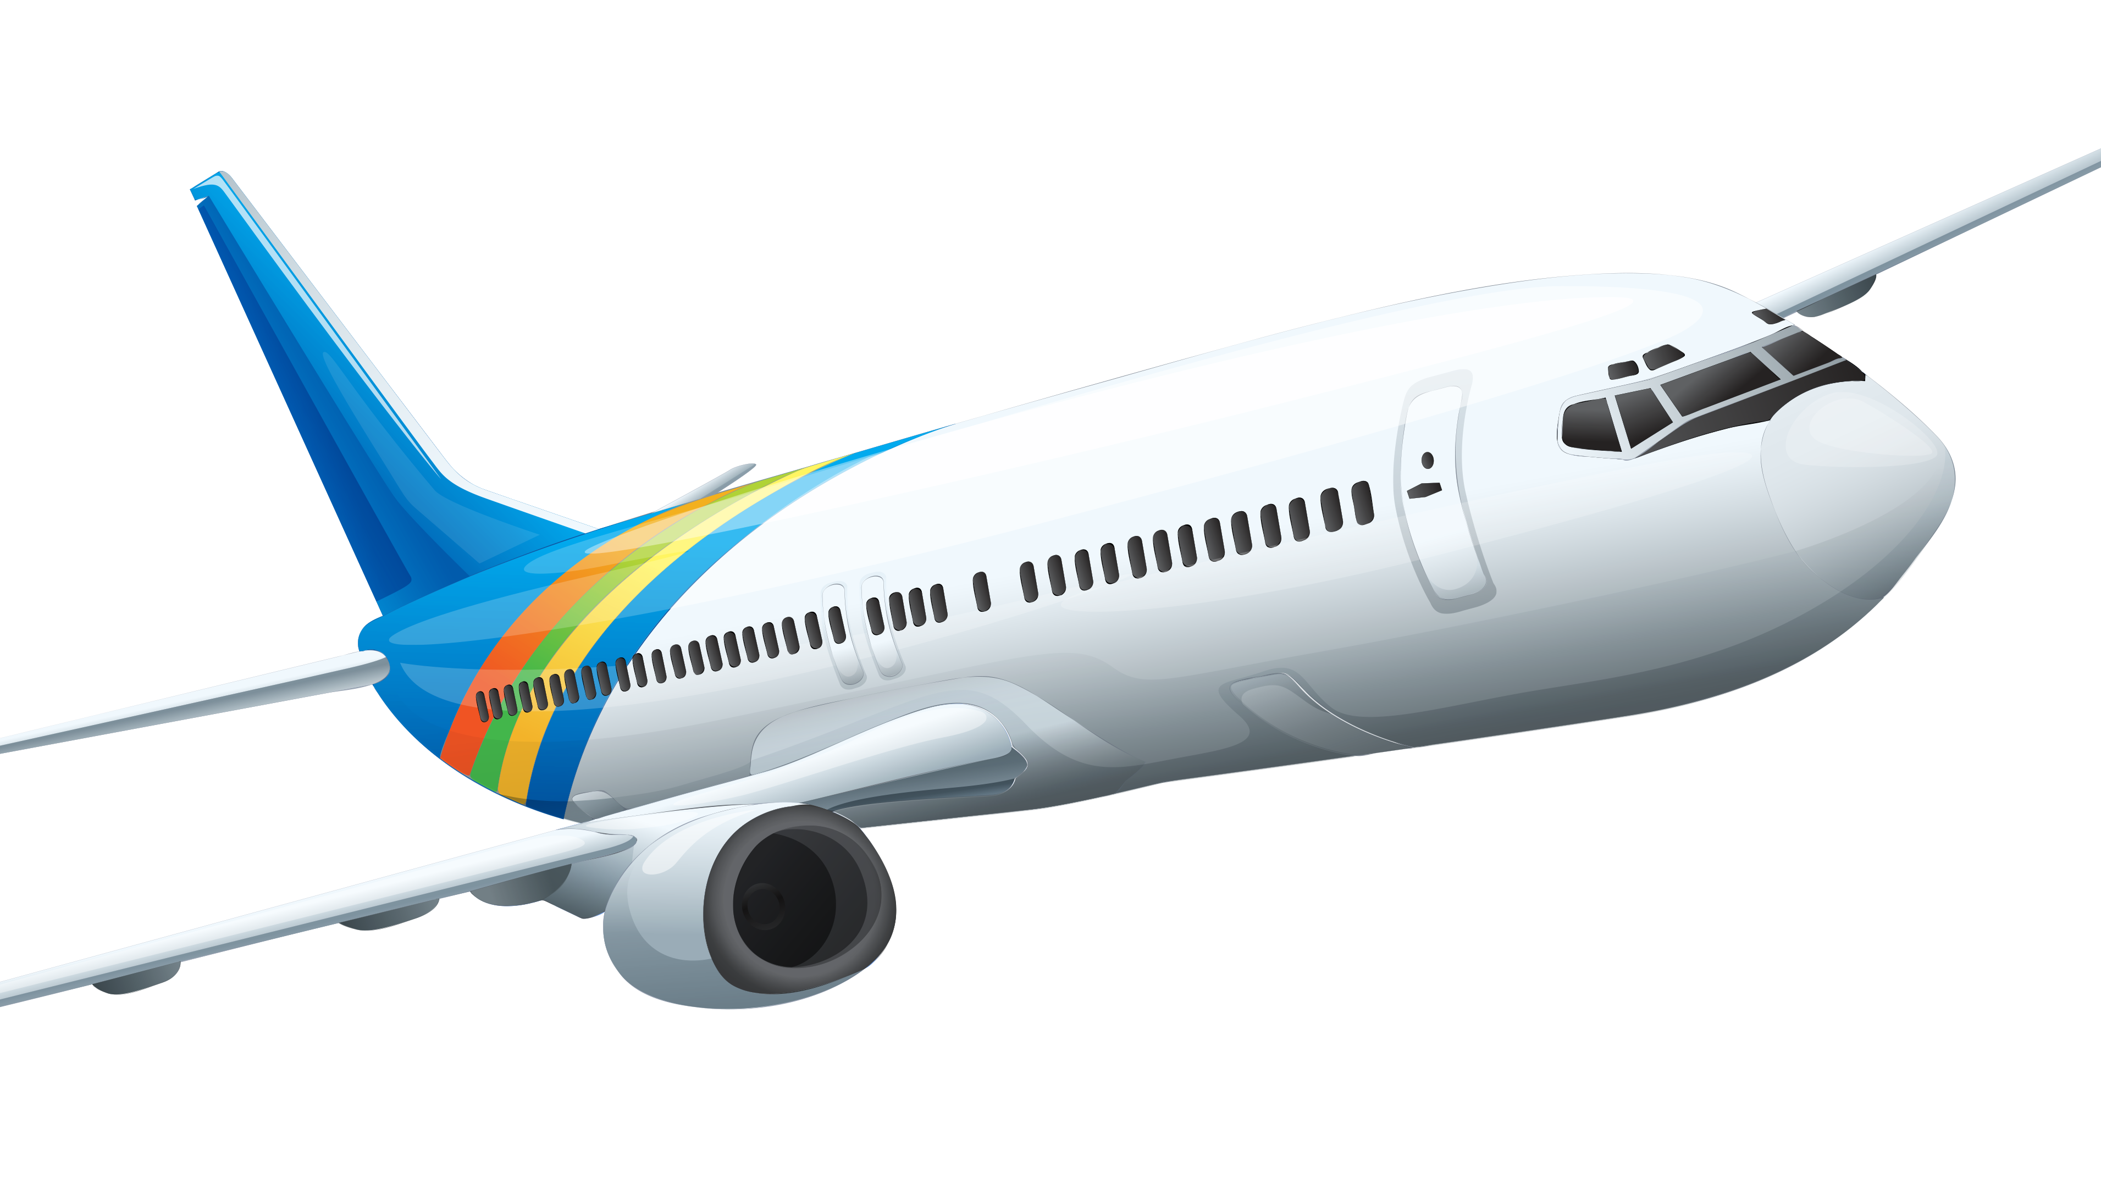
Let’s Fly to details

